Slide 1

Software Engineering
SHRIMATI INDIRA GANDHI COLLEGE
(Nationally Accredited with ‘A’ Grade(3rd Cycle) by NAAC)
An ISO 9001:2015 Certified Institution
Tiruchirappalli – 620 002
DEPARTMENTS OF COMPUTER SCIENCE, IT & APPLICATIONS
AUTHOR:
Dr.M.GOMATHY
Asst. Professor
Department of Computer Science
Shrimati Indira Gandhi College
Trichirappalli-02

Slide 2
ESTIMATION AND SCHEDULING OF SOFTWARE PROJECTS

Slide 3
SOFTWARE SIZING
It helps the project manager to further predict the effort and time which will be needed to build the project.
Various measures are used in project size estimation.
Lines of Code •
Number of entities in ER diagram •
Total number of processes in detailed data flow diagram
Function points

Slide 4
Lines of Code (LOC):
LOC count the total number of lines of source code in a project. The units of LOC are: •
KLOC- Thousand lines of code •
NLOC- Non comment lines of code •
KDSI- Thousands of delivered source instruction
The experts use it to predict the required size of various components of software and then add them to get the total size.

Slide 5
2. Number of entities in ER diagram:
It describes the entities and its relationships.
The number of entities in ER model can be used to measure the estimation of size of project.
Number of entities depends on the size of the project.
This is because more entities needed more classes/structures thus leading to more coding.

Slide 6
3.Total number of processes in detailed data flow diagram:
Data Flow Diagram(DFD) represents the functional view of a software.
The model depicts the main processes/functions involved in software and flow of data between them

Slide 7
4.Function Point Analysis:
The number and type of functions supported by the software are utilized to find FPC(function point count).
The steps in function point analysis are: •
Count the number of functions of each proposed type. •
Compute the Unadjusted Function Points(UFP).
Find Total Degree of Influence(TDI). •
Compute Value Adjustment Factor(VAF). •
Find the Function Point Count(FPC).

Slide 8
• Count the number of functions of each proposed type:
External Inputs: Functions related to data entering the system. •
External outputs: Functions related to data exiting the system. •
External Inquiries: They leads to data retrieval from system but don’t change the system. •
Internal Files: Logical files maintained within the system. Log files are not included here. •
External interface Files: These are logical files for other applications which are used by our system.

Slide 9
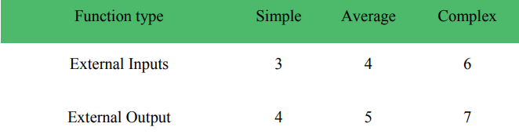
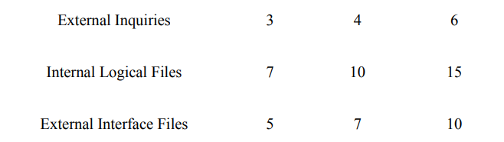
• Compute the Unadjusted Function Points(UFP):

Slide 10
• Find Total Degree of Influence:
14 general characteristics
The sum of all 14 degrees of influences will give the TDI.
The range of TDI is 0 to 70.
The 14 general characteristics are: Data Communications, Distributed Data Processing, Performance, Heavily Used Configuration, Transaction Rate, Online Data Entry, End-user Efficiency, Online Update, Complex Processing Reusability, Installation Ease, Operational Ease, Multiple Sites and Facilitate Change.
Each of above characteristics is evaluated on a scale of 0-5.

Slide 11
Compute Value Adjustment Factor(VAF):
VAF = (TDI * 0.01) + 0.65
Function Point Count:
FPC = UFP * VAF

Slide 12
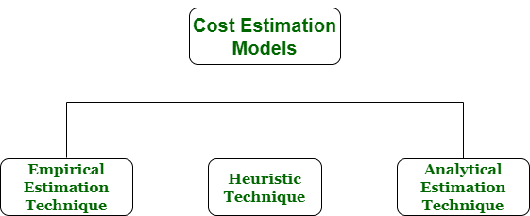
ESTIMATION MODELS:

Slide 13
COCOMO Model
COCOMO (Constructive Cost Model) is a regression model based on LOC, i.e number of Lines of Code.
Predicting the various parameters associated with making a project such as size, effort, cost, time and quality.
Boehm’s definition of organic, semidetached, and embedded systems

Slide 14
1. Organic
If the team size required is adequately small, the problem is well understood and also the team members have a nominal experience regarding the problem.
2. Semi-detached
If the vital characteristics such as team-size, experience, knowledge of the various programming environment lie in between that of organic and Embedded.
3. Embedded
The highest level of complexity, creativity, and experience requirement.
Larger team size, the developers need to be sufficiently experienced and creative to develop such complex models.

Slide 15
Types of COCOMO Models
Basic COCOMO:
Quick and slightly rough calculations of Software Costs. Its accuracy is somewhat restricted due to the absence of sufficient factor considerations.
Intermediate COCOMO:
Various other factors such as reliability, experience, Capability. These factors are known as Cost Drivers
Detailed COCOMO:
Incorporates all characteristics of the intermediate version with an assessment of the cost driver’s impact on each step of the software engineering process. The detailed model uses different effort multipliers for each cost driver attribute. The whole software is divided into different modules and then we apply COCOMO in different modules to estimate effort and then sum the effort.

Slide 16
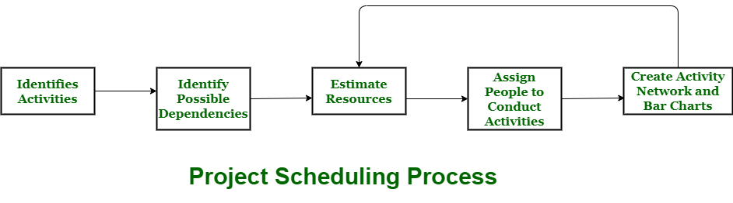
Project Scheduling
Used to communicate and know about that tasks are needed and has to be done or performed and which organizational resources will be given or allocated to these tasks and in what time duration or time frame work is needed to be performed.
Important form of project schedule is Gantt chart.

Slide 17
Thanks!
Any questions?

